Slide 1
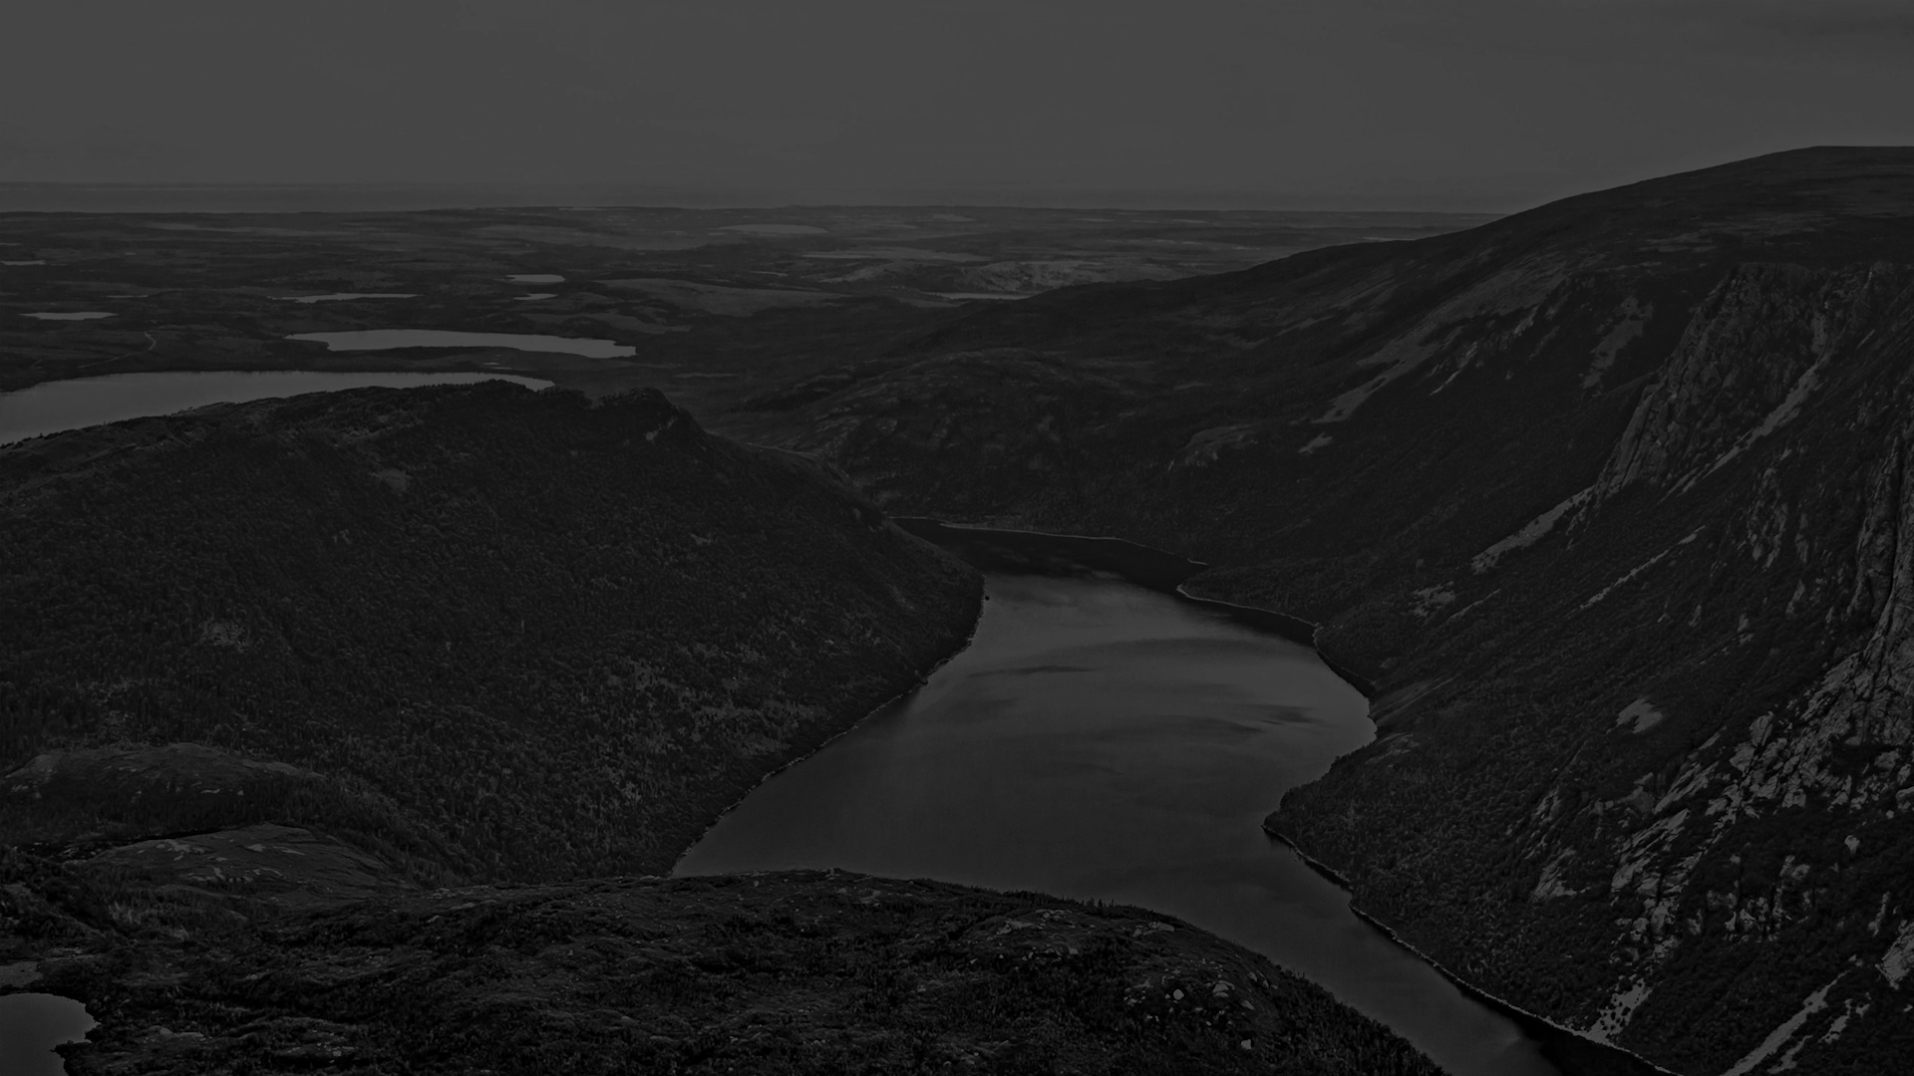
DISTRICT SCALE
HIGH-GRADE GOLD PROJECTS
IN NEWFOUNDLAND
Join us on our exciting journey
CSE: NFLD
OTCQB: NFLDF
Frankfurt: A2QDKZ
www.exploits.gold
October 2021

Slide 2
CAUTIONARY NOTES
Investors are cautioned that, except for statements of historical fact, certain information contained in this document includes “forward-looking information”, with respect to a performance expectation for Exploits Discovery Corp. Such forward-looking statements are based on current expectations, estimates and projections formulated using assumptions believed to be reasonable and involving a number of risks and uncertainties which could cause actual results to differ materially from those anticipated.
Such factors include, without limitation, fluctuations in foreign exchange markets, the price of commodities in both the cash market and futures market, changes in legislation, taxation, controls and regulations of national and local governments and political and economic developments in Canada and other countries where Exploits Discovery Corp. carries-out or may carry-out business in the future, the availability of future business opportunities and the ability to successfully integrate acquisitions or operational difficulties related to technical activities of mining and reclamation, the speculative nature of exploration and development of mineral deposits located, including risks in obtaining necessary licenses and permits, reducing the quantity or grade of reserves, adverse changes in credit ratings, and the challenge of title.
The Company does not undertake an obligation to update publicly or revise any forward-looking statements or information, whether as a result of new information, future events or otherwise, unless so required by applicable securities laws.
Nick Ryan P.Geo., Senior Geologist with Exploits Discovery Corp., is a registered professional geoscientist as defined by National Instrument 43-101. Mr. Ryan has reviewed and approved the technical portion of this corporate presentation.

Slide 3
EXPLOITS DISCOVERY: NEWFOUNDLAND GOLD RUSH
» 5/5 drill permits received » Drilling commenced May 27th 2021…
COMMANDING LAND POSITION:
100% ownership of a 2,000+ km² land position in the Exploits Subzone.
200 km+ strike length of deep-seated regional structures which include the Appleton Fault, Dog Bay Line, GRUB Line, Schooner Fault, and Mt Peyton Linear.
PROVEN EXPLORATION MODEL:
Exploration model comparable to Kirkland Lake Gold’s Fosterville Mine model; high-grade structurally hosted epizonal gold.
Proven by New Found Gold’s success in discovery at the Keats, Lotto, and Knob Zones.
Goldspot Discoveries Corp retained for machine learning data analysis.
HIGH-GRADE SAMPLES:
High-grade gold in outcrop up to 194 g/t Au, float boulders with visible gold up to 700 g/t Au.
3 visible gold occurrences and counting.
STRONG Cash Position:
Well funded with just over $14M CAD cash on hand.
Zero debt.

Slide 4
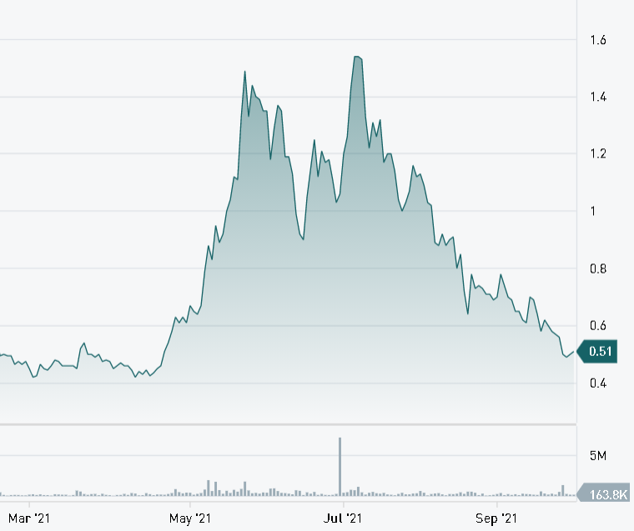
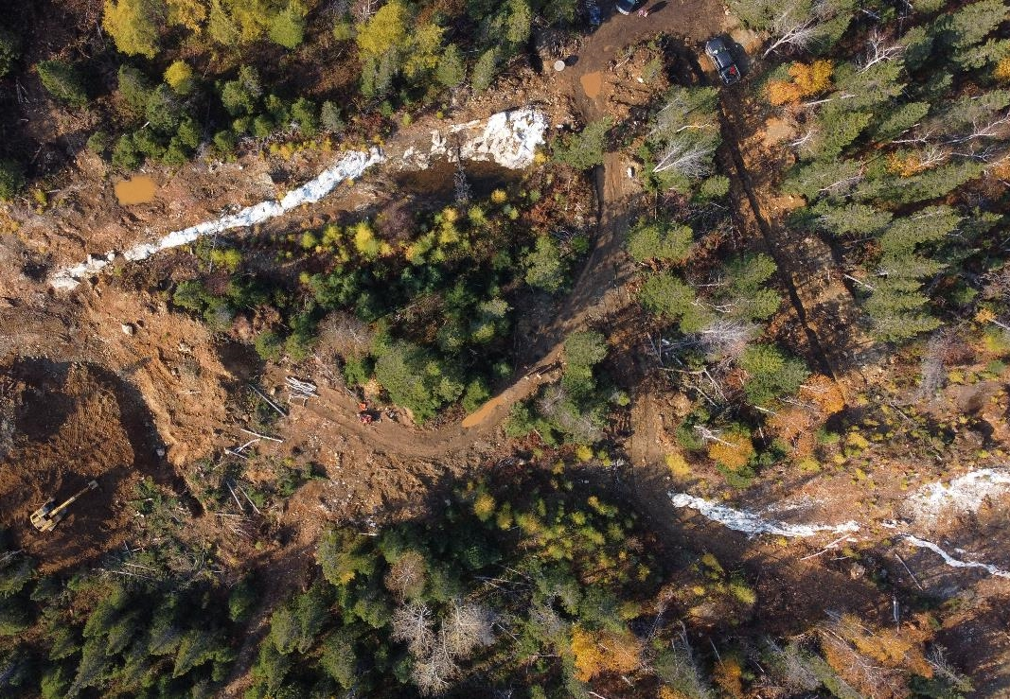
CAPITAL STRUCTURE
Exploits Discovery: NFLD
Shares Outstanding | 103.4 million
Warrants | 29.6 million (avg strike $0.68)
Options | 7.7 million (avg strike $0.79)
Fully Diluted | 140.8 million
Major Shareholders | Eric Sprott: 25.7% New Found Gold (NFG): 14.1% NL Prospectors & Insiders
Market Cap | $58M (Oct 12, 2021)
Notes:
In 2021 we will need to raise capital a couple of times to advance our projects.
We have a strong management team, tight share structure, and partners in New Found Gold, Goldspot and others that ensure we are tightly controlled and invested in our success.

Slide 5
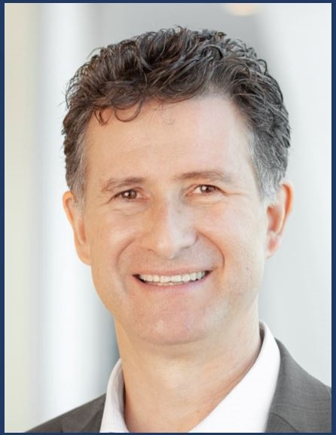
KEY MANAGEMENT
JEFF SWINOGA, PRESIDENT, CEO & DIRECTOR Mr. Swinoga is a highly accomplished mining executive with over 25 years of executive and management experience in the areas of finance, project development and project construction. Most recently, he was the National Mining and Metals Leader at EY Canada and CEO of First Mining Gold. Previously he was Chief Financial Officer (“CFO”) of Torex Gold Resources Inc. (“Torex”) where, during his four-year tenure, he led the US$400 million financing of Torex’s US$800 million El Limon-Guajes gold mine on the Morelos property and led his team during Torex’s transition from an exploration and development company to a mid-tier gold producer. Prior to Torex, Mr. Swinoga spent four years as the CFO of North American Palladium Ltd. (“NAP”), during which time NAP financed and constructed the underground Offset Zone expansion project for the Lac des Iles Mine, in addition to acquiring and building two gold producing mines in Québec. Further, he spent three years as CFO of HudBay Minerals Inc., where, from its initial public offering in late 2004, grew to a market capitalization of over $2 billion. Jeff also spent seven years at Barrick Gold Corporation as a senior officer with responsibilities that included project financing of Barrick’s Bulyanhulu and Veladero projects. He is a Chartered Professional Accountant and holds a Master of Business Administration degree from the University of Toronto as well as a Bachelor's degree (Honours) in Economics from the University of Western Ontario. Mr Swinoga was also elected to the Board of PDAC this year and is also a member of their audit committee.
CHRISTOPHER HUGGINS, DIRECTOR & VP Exploration Mr. Huggins’ experience with grassroots exploration geology, mining, construction, and technology industries provide a broad range of insights to the company. Following a Bachelor of Science in Honours Geology from the University of British Columbia, Mr. Huggins began his career as an exploration geologist with Homestake Mining in regional exploration around Eskay Creek Mine, Snip Mine and Stewart camps, and including project evaluations and large-scale geological and structural mapping in northern Chile. His involvement over the past 10 years in project feasibility, financing and development of creative capital equipment packages has provided mining projects and operating mines with unique opportunities to drive efficiency and manage operational risk.
MONTY SUTTON, CFO​ While working towards a CGA designation in the early 1990, Mr. Sutton was a Senior Management Accountant with MacMillan Bloedel preparing budgets, analyzing costs, and assisting in the design and implementation of new accounting systems. Monty Sutton’s experience in the investment industry started with a brief stint on the Vancouver Stock Exchange trading floor in 1987, Mr Sutton spent most of his career as an investment advisor, trader, and insurance specialist with PI Financial Corp. in Vancouver. During this time he participated in raising over $100 million for junior mining companies and managed over 1,500 client accounts. While Mr. Sutton was the Corporate Development Manager with eCobalt Solutions they raised over $30 million for the development of their Idaho Cobalt Project.

Slide 6
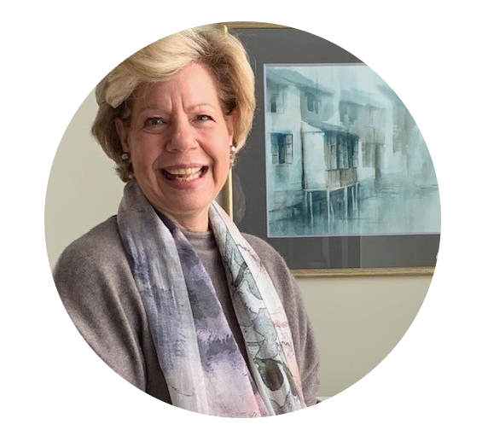
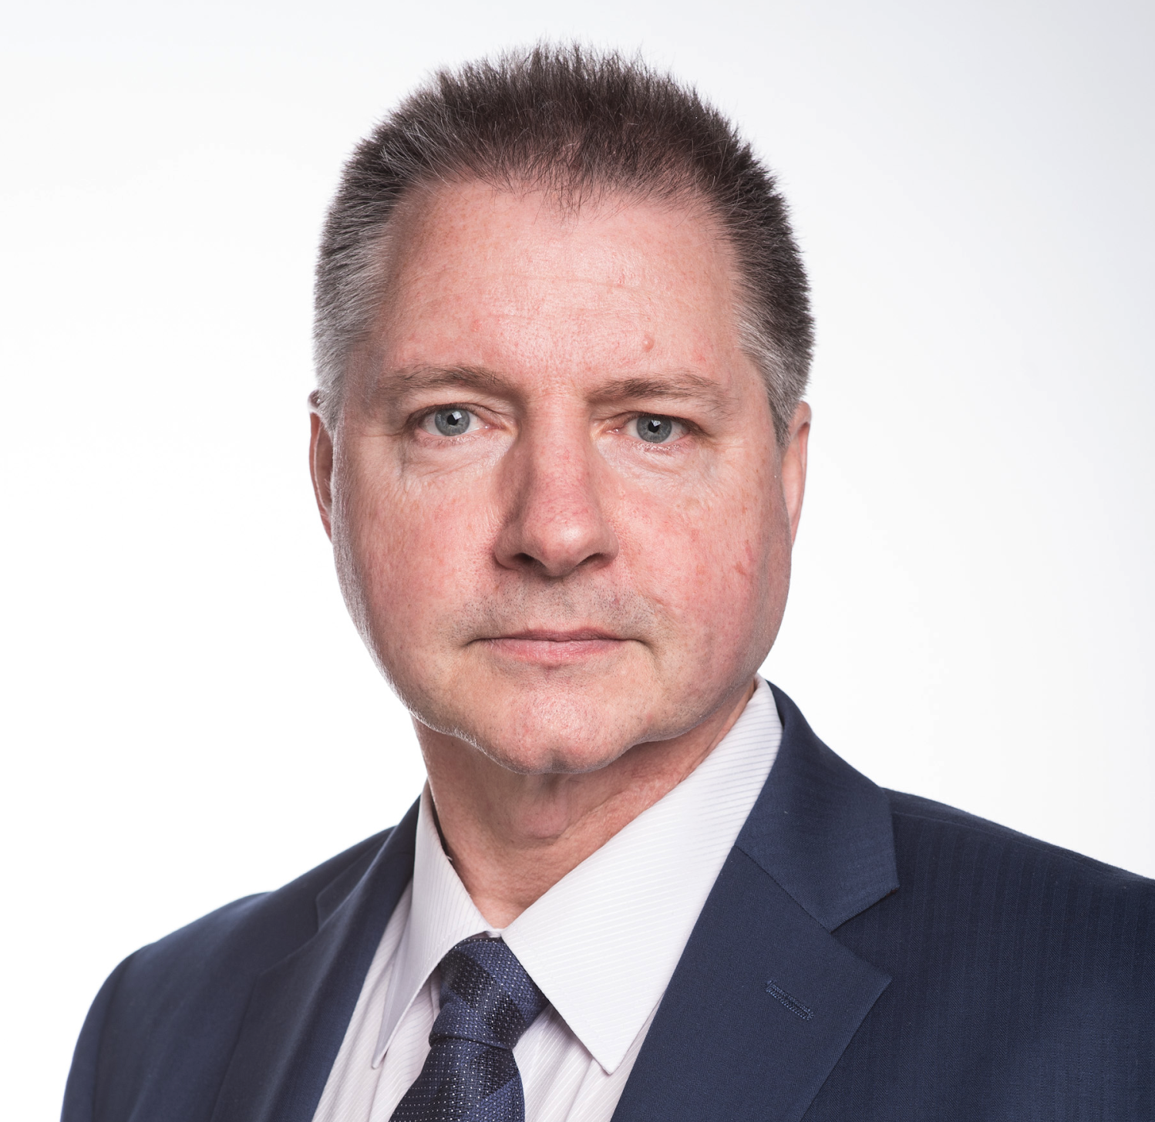
MANAGEMENT & DIRECTORS
SIRI C. GENIK, DIRECTOR Ms. Genik is the principal of BRIDGE© and during the course of her career has spent over 25 years working on major capital projects, from the Americas to the Middle East, Africa, Europe and Eurasia. Her experience lies primarily in Non-technical Risk Assessments and Strategic Planning, ESG and Sustainability, Stakeholder Relations and External Affairs. Siri also has extensive experience in negotiating agreements and mediation. Her focus has been developing strategies that bring together the business solution with the governmental policies, socioeconomic concerns and community priorities. Siri builds bridges between the boardroom, the project world and the teams on the ground, focusing on providing long-term value and achieving cost-driven results.
Ms. Genik presently serves as a Director of the Board for the Prospectors & Developers Association of Canada (PDAC); Co-Chair of the Sustainability and Lands & Regulations Committees (PDAC); Director, Imperial Mining Group & Chair of the Audit Committee and Governance Committee. She is a CIM Distinguished Lecturer – CSR (2018-2019); Director of the Canada-Mongolia Chamber of Commerce and previously served as Vice President, Women-in-Mining-Canada (2015- 2021).
Ms. Genik holds a Mediation certification (Canada), is a member of the Bar of the Province of Québec; holds her LL.L from the Université de Montréal plus holds both a Business Administration Certificate and B.A., Political Science and Economics from McGill University. Siri perfectly tri-lingual (English, French and Spanish).
ROD HUSBAND, DIRECTOR Rod Husband, B.Sc. Geology, P.Geo, is an economic geologist with over 30 years experience in the junior resource sector. He served as director and officer of several Canadian public companies where he focused on their management and corporate development including the evaluation, financing, exploration and development of several quality projects culminating the development of a 3 million-ounce gold mine.
He is the founding partner of Cipher Research where he has spent the last 6 years conducting research and analysis on hundreds of companies and projects and helping develop detailed valuation models used to assess prospective investment.

Slide 7
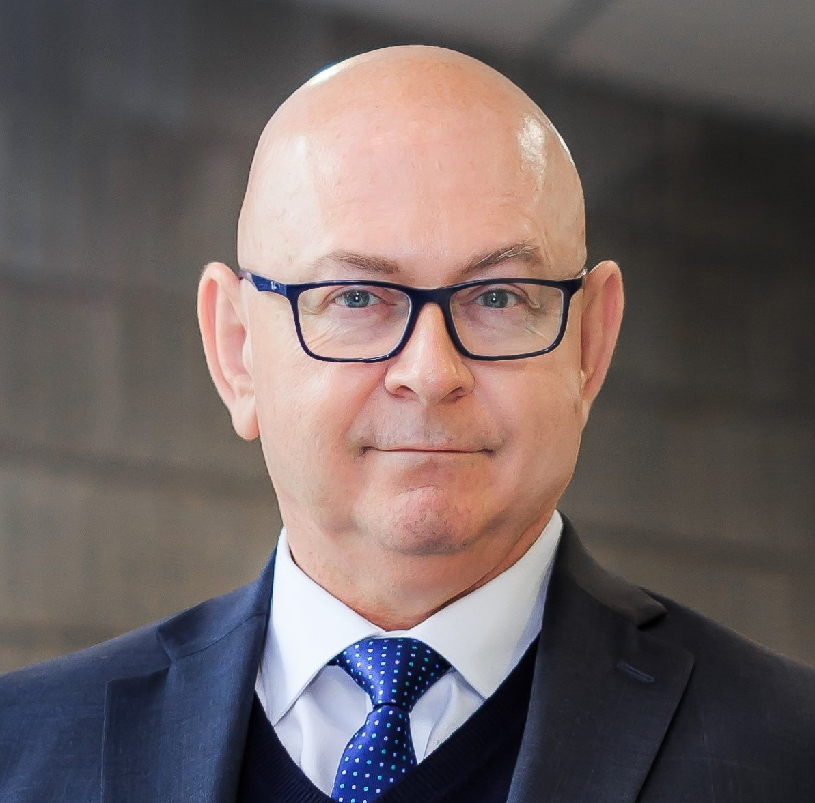
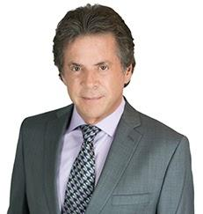
MANAGEMENT & DIRECTORS
LARRY SHORT, DIRECTOR​ Mr. Short was born and raised in Carbonear, Newfoundland. With over 32 years of experience, he is a CPA, CGA, a CFP, a CIM and Portfolio Manager with ShortFinancial, Industrial Alliance, a full service wealth management practice with registered offices in St. John's and Toronto serving clients across Canada, the US and the Caribbean. Larry has published two books, numerous articles and has been featured on CBC, BBC, Business News Network, Macleans and other national media outlets.
WILLIAM M. SHERIFF, DIRECTOR An entrepreneur and visionary with over 30 years' experience in the minerals industry and the securities industry and has been responsible for capital raises in excess of $300-million. Mr. Sheriff was a pioneer in the uranium renaissance as co-founder and Chairman of Energy Metals Corp. and was responsible for compiling the largest domestic uranium resource base in US history before the company was acquired by Uranium One Corp for $1.8 Billion. ​
Mr. Sheriff presently serves as the Executive Chairman of enCore Energy Corp. and Chairman of Golden Predator Mining Corp. Mr. Sheriff also serves as a Director of Ely Gold Corp. and Director of Group 11 Technologies Inc, a private company committed to the development and application of environmentally and socially responsible precious metals mineral extraction as an alternative to conventional mining methods. ​Mr. Sheriff previously served as a Director of Western Lithium USA Inc., Uranium One Inc., Midway Gold Corp., Eurasian Minerals Inc. and Starcore International Mines Ltd. Mr. Sheriff was also a registered representative, holding positions with A.G.Edwards and Mitchum Jones and Templeton, in addition to having his own securities firm. Mr. Sheriff holds a B.Sc. degree (Geology) from Fort Lewis College, Colorado and an MSc in Mining Geology from the University of Texas-El Paso and compiled one of the largest privately held mining databases in the world.​

Slide 8
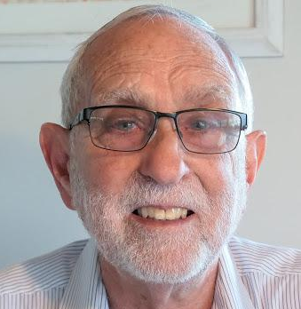
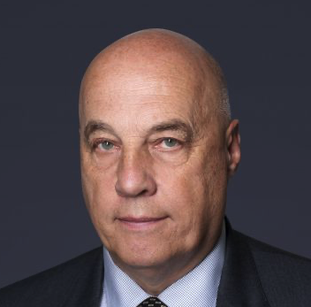
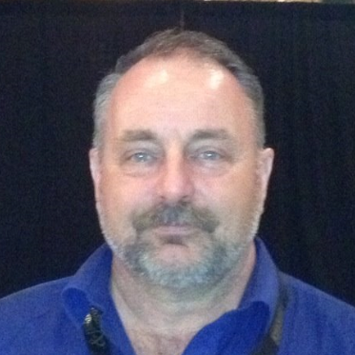
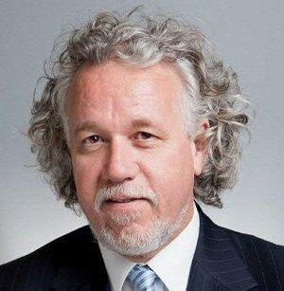
ADVISORY BOARD
DAVID GROVES, PHD David Groves was educated at Hobart High School and University of Tasmania, completing a PhD on the giant Mt Bischoff tin deposit under the mentorship of Mike Solomon. After a period with the Geological Survey of Tasmania, David was appointed Lecturer in Economic Geology at the University of Western Australia (UWA) in 1972. In 1987, he was awarded a Personal Chair at UWA and formed the Centre for Strategic Mineral Deposits, which morphed into the Centre for Global Metallogeny. Lead author of: “Structural geometry of orogenic gold deposits: Implications for exploration of world-class and giant deposits”. He had a very successful academic career in terms of approximately 500 highly-cited published papers and book chapters, many keynote and invited lectures, and mentorship of many outstanding postgraduates, He has been President of GSA, SEG and SGA during his career and represented Australia on UNESCO committees.
NICK RODWAY, P.Geo Mr. Rodway is a registered Professional Geologist and has spent more than a decade working with Canadian exploration and mining companies. He graduated from Memorial University of Newfoundland with a Bachelor of Science (Geology) and completed a Masters Degree in Business Resource Leadership at Queens University. Nick has extensive ties to Newfoundland and brings to the team vast contacts in the local exploration and mining community. He was instrumental in the identification of all projects that now call Exploits Discovery Corp. their home. Nick has played a strategic role as a Director with Core Assets Corp., Saville Resources Inc. and Kings Bay Resources Corp. assisting with raising capital, project targeting and mineral exploration planning. Mr. Rodway also sits on the board of several other private exploration and technology companies in Canada.
DAVID GOWER
Mr. Gower has been involved in the mineral industry for over 30 years, including positions with Falconbridge Ltd. and Noranda Inc. (now Glencore Canada Corp.).
GARY LEWIS, CET​ Gary has over 35 years of experience in exploration and project development in Newfoundland and is a driving force of exploration in the Exploits subzone. In 2000, he introduced Rubicon Minerals to the mineral potential of the area resulting in numerous gold discoveries.
ANDREW LEE SMITH Mr. Smith is a professional geologist who has over 30 years of experience successfully exploring, developing and operating African and North American base metal and precious metal mining projects.
DAVID SHAW PHD Dr. Shaw was both a geologist and an analyst, with an extensive career.

Slide 9
NEWFOUNDLAND’S 21st CENTURY GOLD RUSH
1970’s Newfoundland Government Regional Survey Geochemical data released...
2000’s Rubicon Minerals Corp.
Regional Exploration & drilling
2019/20 Exploits Discovery Corp.
Land acquisition; exploration begins mid-2020, drilling started late May 2021.
v
THIS IS THE START OF OUR STORY…
1980’s Noranda Inc.
Regional Exploration with substantial drilling across the island.
2016/17 New Found Gold
Collin Kettell and Denis Laviolette build NFG land position and start their exploration in Newfoundland, leading to 2019 discovery @ Keats Zone.
2021 Exploits Discovery Corp
First two drill phases complete on our initial targets and are currently awaiting assay results.
Notes:
Newfoundland is experiencing a 21st Century gold rush that is long overdue. Gold exploration work has been done across Newfoundland for over 30 years, but new exploration models and technologies allow us to now see through the glacial till and overburden, and look for gold in places that were not given a proper evaluation in the past. This is an exciting place to be, and Exploits Discovery has the best position (outside of New Found Gold) to advance to a new discovery.

Slide 10
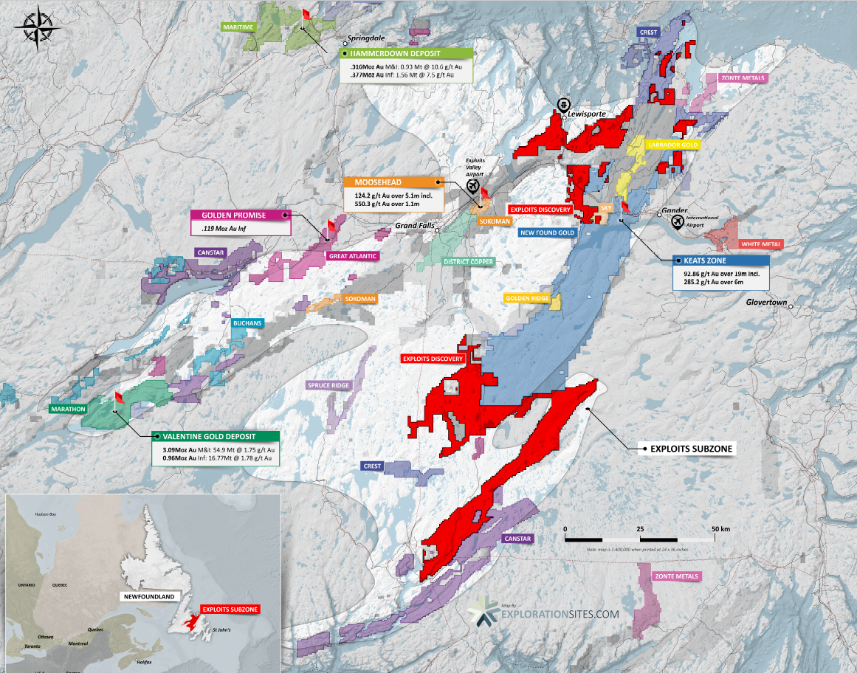
EARLY MOVER ADVANTAGE: EXPLOITS
In September 2020, the Area Play Map looked like this…
Drill core samples at our Jonathan’s Pond target… beauty underground as well as above! Our team is excited and looking forward to exploring the rest of our 2000 square kms!
= New Found Gold
= Exploits Discovery

Slide 11
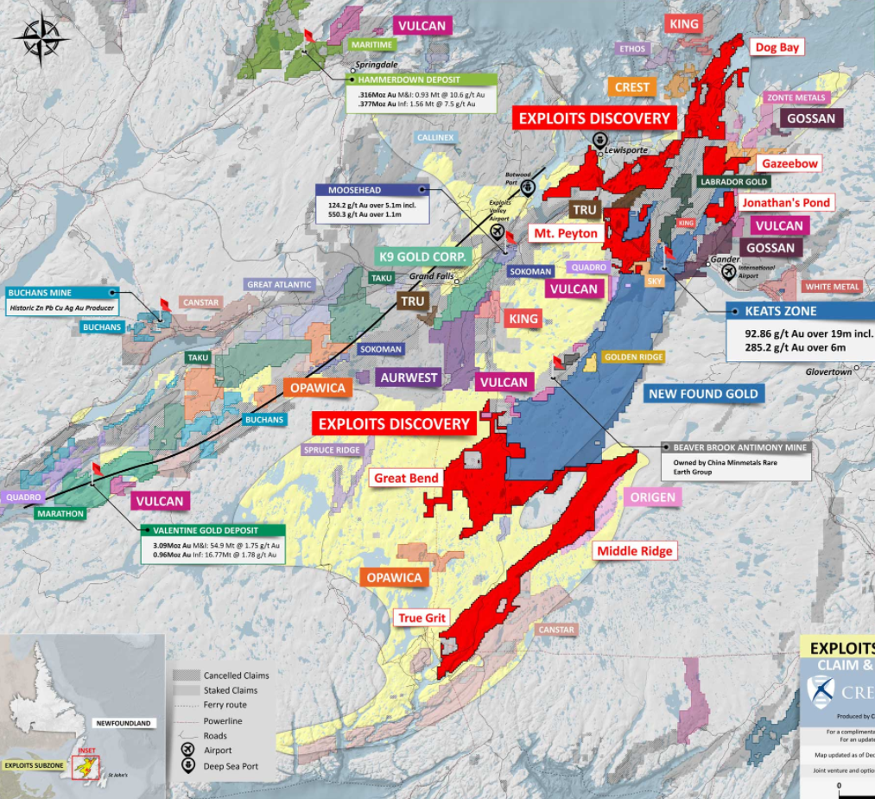
EARLY MOVER ADVANTAGE: EXPLOITS
By December 2020, the Area Play Map had developed significantly.
Many new companies had joined the gold rush in Newfoundland and Exploits further consolidated its’ position with acquisitions from New Found Gold and others.

Slide 12
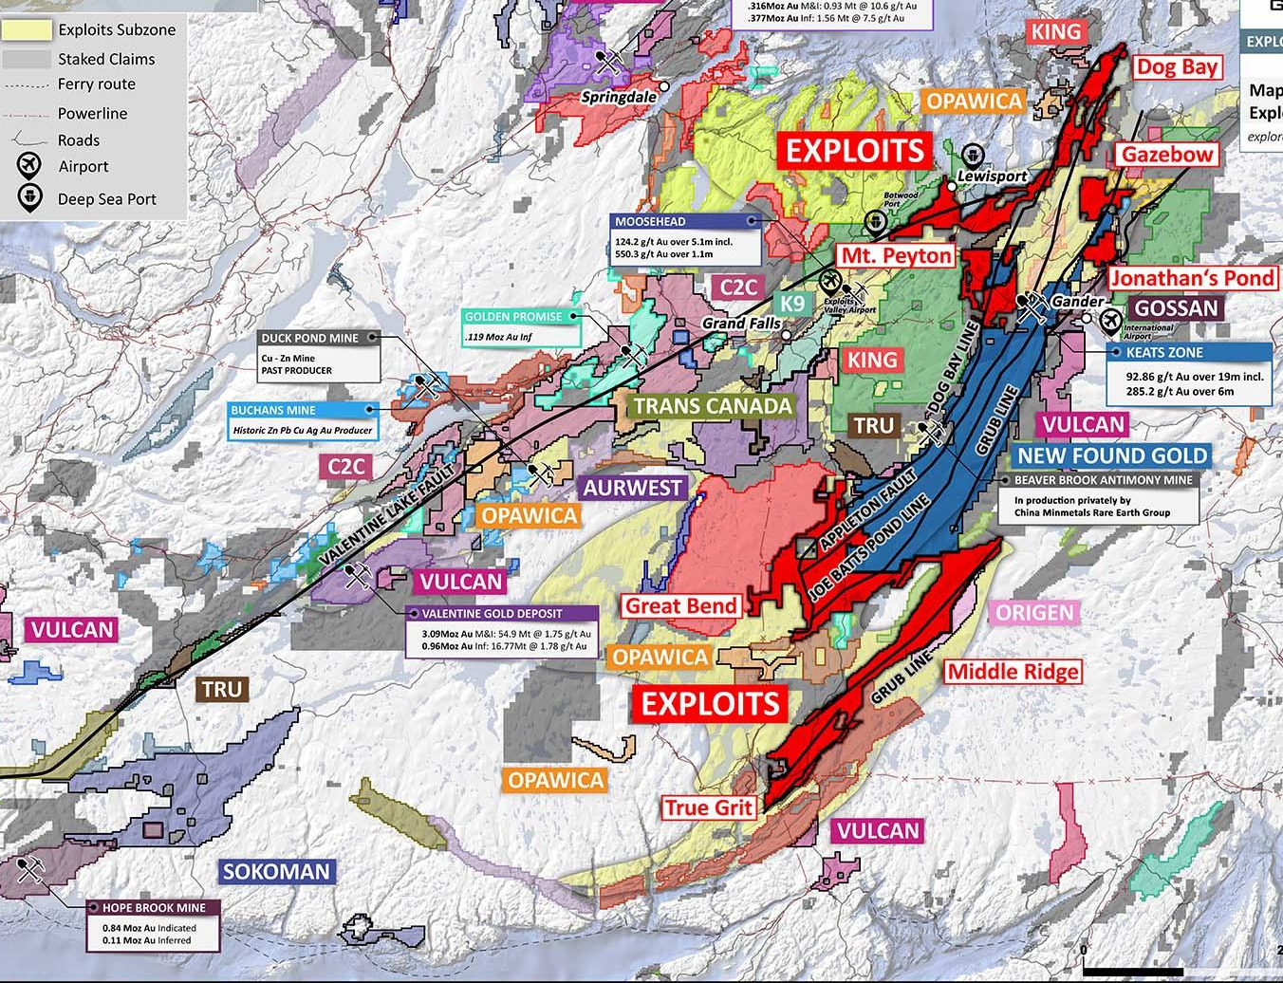
EARLY MOVER ADVANTAGE: EXPLOITS
As of June 2021, the Area Play Map has almost completely filled in… and Exploits has one of the most favourable land positions in Newfoundland.

Slide 13
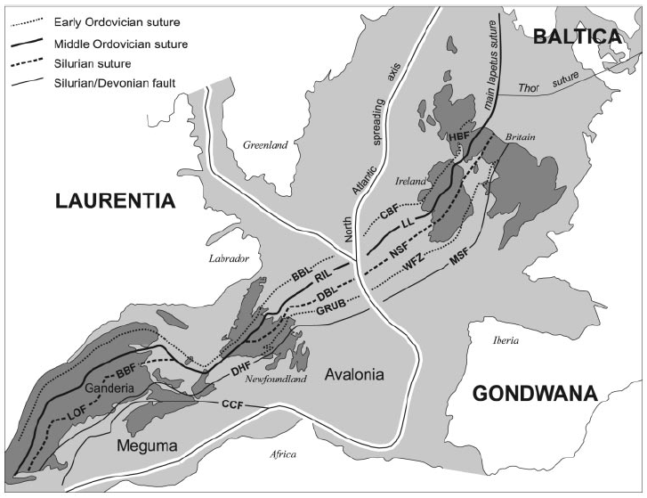
EXPLOITS SUBZONE GOLD BEARING MEGA-STRUCTURES
Deep seated faults and fluid conduits form as the Iapetus closes resulting in mega-structures running from North Carolina to Finland.
The size of the Exploits Subzone is comparable to the Abitibi gold camp in Quebec and Ontario. Imagine: 100 years of discovery vs. a brand new camp of equal size and discovery opportunity.
These structures are associated with large scale Orogenic gold deposits such as Haile (2.8m oz Au M&I, 3.1m oz Au P&P), and Dalradian (3m oz Au M&I, 3.1m oz Au Ind).
Gold deposits form where you have massive fluid flow of gold enriched fluids and structural discontinuity to create traps to deposit the gold.
The Exploits Subzone has been identified as having all the ingredients for major gold discovery as has been demonstrated by Marathon Gold (3.1m oz Au M&I, 1m oz Au Ind) and New Found Gold, (Keats Zone discovery).
EXPLOITS’ PROPERTIES
Map showing the position of Iapetus Ocean suture zones.
BBL: Baie Verte-Brompton Line; DBL: Dog Bay Line; DHF: Dover-Hermitage Fault; GRUB: Gander River Ultramafic Belt; RIL: Red Indian Line
Source: Pollock et al, 2007.
Notes:
The Exploits Subzone is a prime environment for true discovery in one of the last easily accessible gold exploration districts in the world.
Prominent regional thrust faulting and Trans-compressional strike-slip movement shows evidence of deep seated fluid conduits with long tectonic history and fluid migration with:
Fosterville exploration model
New Found Gold demonstrating model in Exploits Subzone rocks
The Goldspot team who picked New Found Gold’s targets is consulting Exploits on targeting
Hosting 200 km of deep seated regional faults and fluid conduits this open space to deposit gold
The Exploits Subzone is one of the worlds last easily accessible district scale gold camps, with road accessible targets, local staffing and infrastructure.
New Found Gold has demonstrated the potential for Fosterville style gold deposits through the 240km length of that Exploits Subzone, which stretches NE-SW across the Island of Newfoundland.
We will utilize the Fosterville model, geochemistry, geophysics, and Artificial Intelligence Modeling to drive discovery on known and new target areas.

Slide 14
EPIZONAL OROGENIC GOLD MODEL CROSS-SECTION
COMPARISON TO FOSTERVILLE SWAN ZONE VICTORIA, AUSTRALIA
EXPLOITS SUBZONE
Appleton Fault
JBP Fault
NW
SE NW
SE
NW
Schooner Fault
SE
Dog Bay Line
GRUB Line
increasing slip on decollement
slip on decollement
OCEANIC CRUST
OCEANIC CRUST
OCEANIC CRUST
1. Ocean closes, compression of oceanic crust on continental crust begins.
2. Increased compression, pressure, folding & faulting. Metamorphic fluids begin to generate deep in the crust.
3. Fluids promote fault failure (seismic pumping). Auriferous fluids migrate up secondary displacement faults and deposits gold into structural traps (dilational site).

Slide 15
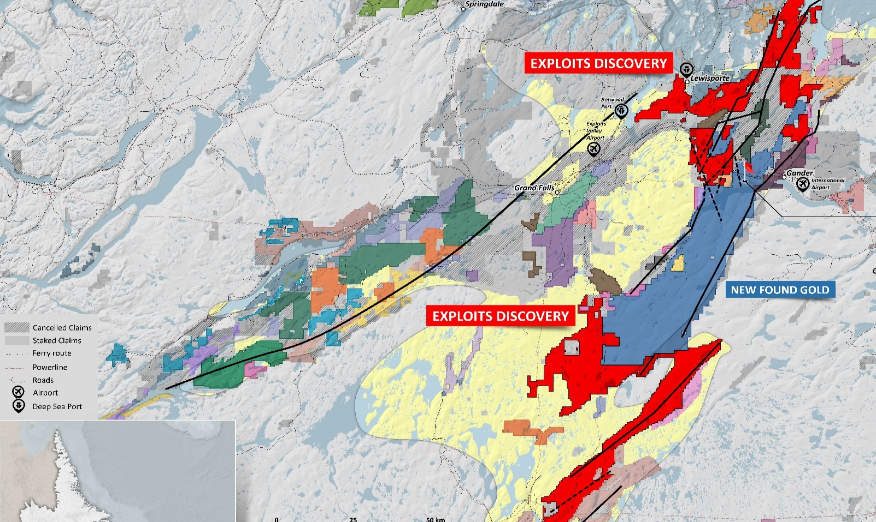
EXPLOITS SUBZONE PRIME FOR DISCOVERY
Dog Bay Line
Appleton Fault
Mt Peyton Linear
Valentine Lake
GRUB LINE
Dog Bay Line
Joe Batts Pond Line
Appleton Fault
Map showing the position of Iapetus Ocean suture zones. BBL: Baie Verte-Brompton Line; DBL: Dog Bay Line; DHF: Dover-Hermitage Fault; GRUB: Gander River Ultramafic Belt; RIL: Red Indian Line
Source: Pollock et al, 2007.
GRUB LINE
Dog Bay Line
Appleton Linear
GRUB Line
Joe Batts Pond
Valentine Lake
Notes:
The Exploits Subzone is a prime environment for true discovery in one of the last easily accessible gold exploration districts in the world.
Prominent regional thrust faulting and Trans-compressional strike-slip movement shows evidence of deep seated fluid conduits with long tectonic history and fluid migration with:
Fosterville exploration model
New Found Gold demonstrating model in Exploits Subzone rocks
The Goldspot team who picked New Found Gold’s targets is consulting Exploits on targeting
Hosting 200 km of deep seated regional faults and fluid conduits this open space to deposit gold
The Exploits Subzone is one of the worlds last easily accessible district scale gold camps, with road accessible targets, local staffing and infrastructure.
New Found Gold has demonstrated the potential for Fosterville style gold deposits through the 240km length of that Exploits Subzone, which stretches NE-SW across the Island of Newfoundland.
We will utilize the Fosterville model, geochemistry, geophysics, and Artificial Intelligence Modeling to drive discovery on known and new target areas.

Slide 16
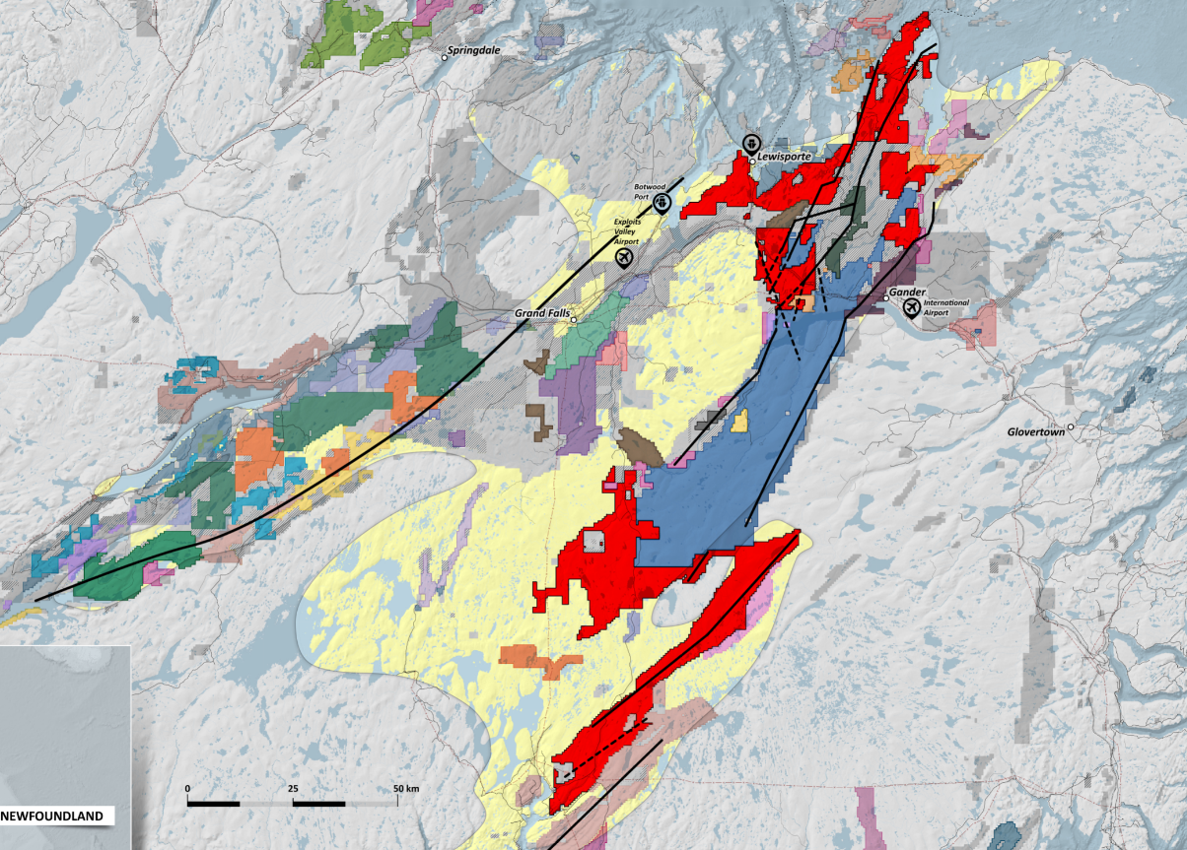
DOG BAY
Dog Bay Line
and Appleton Fault
Visible gold in outcrops
SGH pending
EXPLOITS’ EXPLORATION SUMMARY
EXPLOITS DISCOVERY
Drill targets defined, permitted, and drilling commenced May 27, 2021.
Geophysics - 13,500 line km were flown to complete the data set across our properties. This allows us to see the fault structures which control mineralization.
Goldspot Discovery Corp’s machine learning A.I. will use all our data to prioritize and advance targets for exploration and drilling.
Exploits Discovery is the only company so far using SGH soil sampling – allowing us to ‘see’ through the glacial till. Three SGH programs with 4,161 samples to date. Great Bear Resources used SGH to great success…
Partnership with other companies to advance exploration on projects will add value and manage risk for shareholders.
MT. PEYTON NORTH
Intersection of Valentine Lake
Structure and Dog Bay line
GAZEEBOW
Joe Batts Pond Line
MT. PEYTON
164 g/t Au grab (Noranda)
JONATHAN’S POND
Visible gold in trenches
SGH + 350m trenching
NFG Partnership (9.9%)
NEW FOUND GOLD
GREAT BEND
Appleton Fault
Dog Bay line
Joe Batts Pond Line
EXPLOITS DISCOVERY
Katie Project
Gold and Zinc
VMS mineralization
MIDDLE RIDGE
GRUB Zone targets
Dog Bay Line
Appleton Linear
GRUB Line
Joe Batts Pond
Valentine Lake
TRUE GRIT
0.6 g/t over 117m
SGH pending
Notes:
With eight unique prospects across our claims, we have initiated soils sampling, geophysics, fieldwork programs in 2020 and those will continue in 2021 with the goal of advancing one or two high value opportunities ourselves.
This leaves huge opportunities for companies to partner with us, share in the risk, AND reward.
We welcome strong management teams and companies to approach us about ground they would like to acquire and explore. We will provide an overview of some key projects here, but detailed information is available on our website.
Our focus as a company is to use the best new technologies and geologic models to explore our ground.
With SGH soil sampling we can ‘see through’ glacial tills to bedrock where Gold can be detected.
Geophysics allows us to see the fault structures that control the deep seated mineralization
Geological modeling (Fosterville) and old fashioned field work (structural mapping, rock and trench sampling) give us a good understanding of the ground.
Artificial Intelligence helps pull all this together and identify targets that may be overlooked, and prioritize high value opportunities.
Exploits Discovery uses all of these tools, and will be advancing towards drilling quickly in early 2021.

Slide 17
DRILL TARGET 2021 PROGRAM OVERVIEW
QUINLAN VEINS
Exploits has drill permits for 5 discrete target areas:
Schooner (Phase 2 drilling beginning)
Quinlan Veins (Phase 1 drilling complete)
Jonathan's Pond (Aug-Sept drilling)
Little Joanna (Nov-Dec drilling)
True Grit (Jan-Feb drilling)
Anticipated drilling dates are subject to change as new data is acquired.
Each of these areas has significant work completed on these targets, strong gold occurrences, and proximity to primary and secondary fault structures – which follows the Fosterville epizonal orogenic exploration model.
LITTLE JOANNA
JONATHAN’S POND
SCHOONER
KEATS ZONE
EXPLOITS DISCOVERY
NEW FOUND GOLD
TRUE GRIT
Dog Bay Line
Appleton Linear
GRUB Line
Joe Batts Pond
Valentine Lake

Slide 18
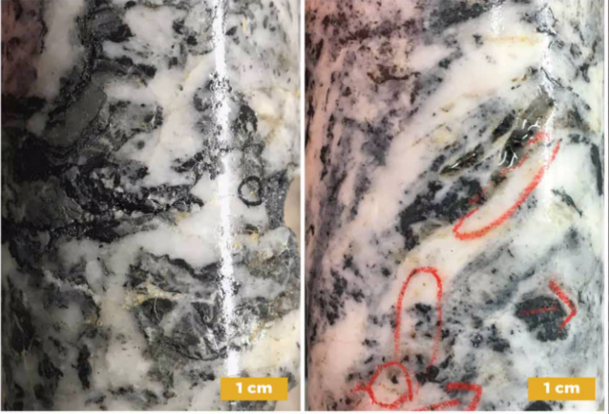
EPIZONAL, OROGENIC STYLE GOLD COMPARABLES
Exploits Discovery Corp.’s projects share the same Epizonal, Orogenic style gold deposits as other successful discoveries on geological structures that continue onto Exploits Discovery ground.
More ground and opportunity for discovery along deep seated, gold mineralized faults in the Exploits Subzone than any other company in the area other than New Found Gold.
Primed for growth in market capitalization with good news flow and developing drill targets.
As of October 12, 2021
COMPANY NAME | MARKET CAP ($CAD)
Exploits Discovery (CSE: NFLD) | $58 M
Labrador Gold (TSX.V: LAB) | $153 M
Marathon Gold (TSX: MOZ) | $723 M
New Found Gold (TSX.V: NFG) | $1.29 B
Left, core from the Keats zone, Queensway gold project; right, core from the Eagle zone, Fosterville mine. Comparison of intense quartz stock work with relict black shale fragments from each deposit. Specks of visible gold are present in quartz veins and their selvages. Gray patches contain fine grained antimony sulfides, boulangerite on left and stibnite on right. (New Found Gold Corp, 2020)

Slide 19
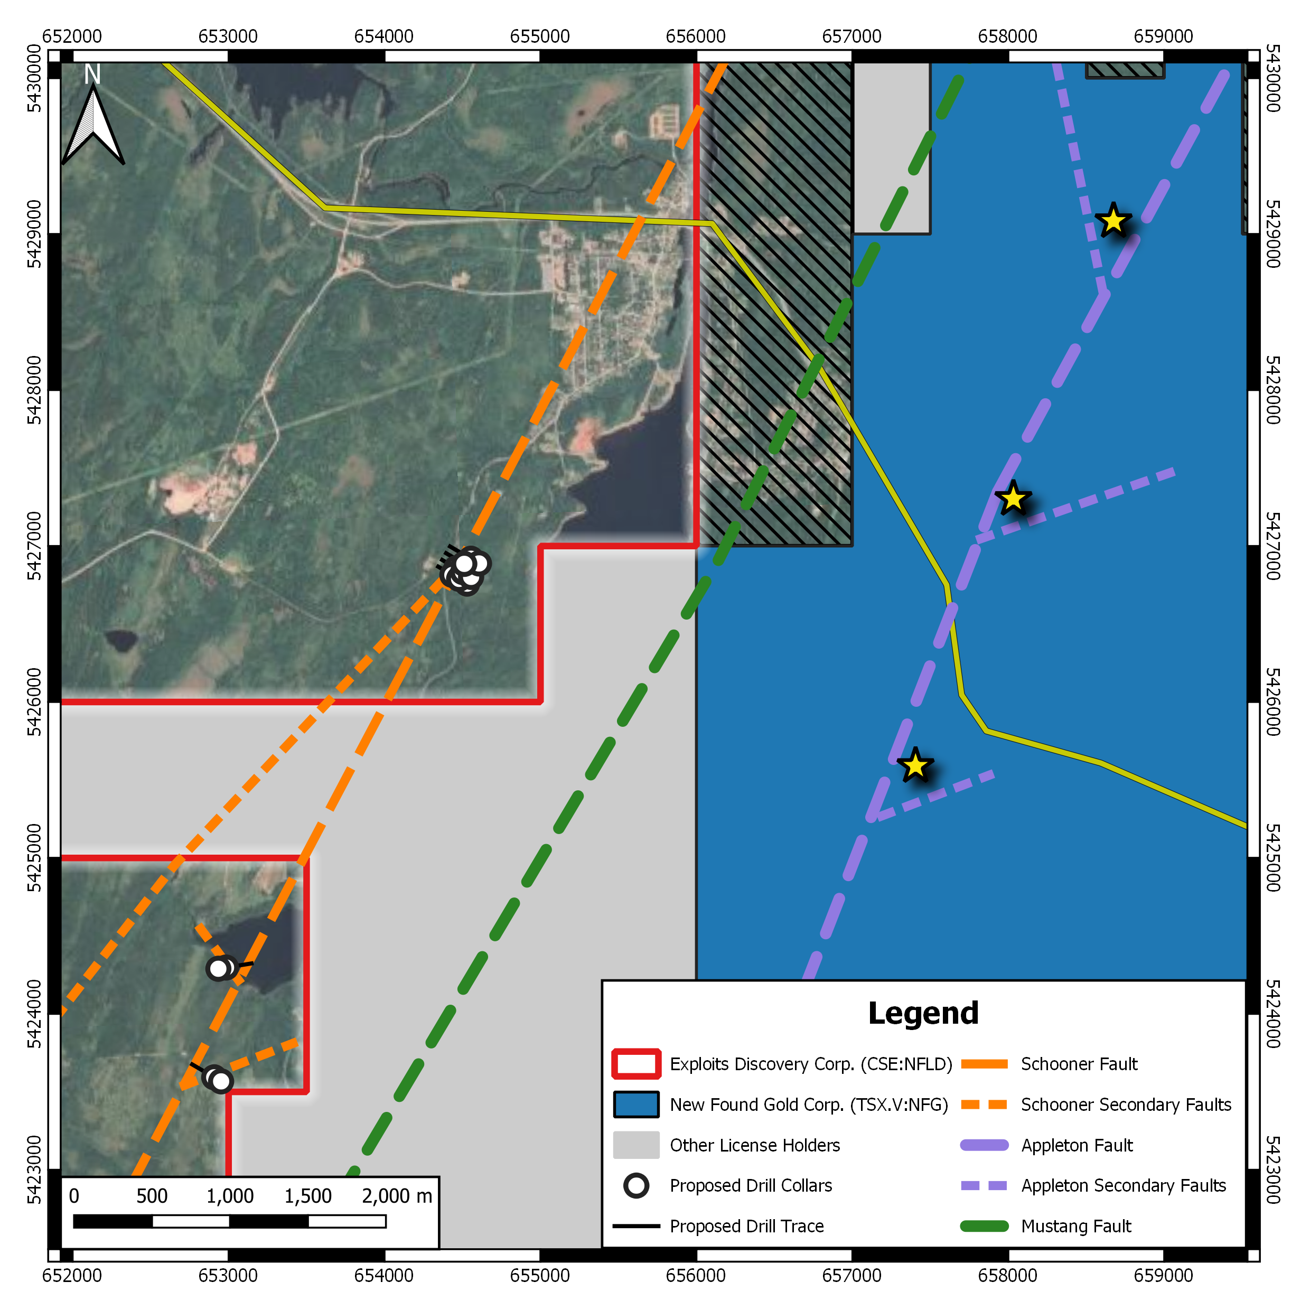
PHASE I DRILLING ASSAYS PENDING: SCHOONER
The Schooner Fault is a newly identified fault zone uncovered by GoldSpot's geophysical and A.I. analysis on existing data compiled by Exploits.
Permitted for drilling totaling 3,000m
Situated 3.5 km west of New Found Gold's (NFG) Keats Zone, the Schooner targets are analogous to NFG's Keats, Lotto, and Knob zones which are identified as a fault splays along Appleton Fault parallel features within the Davidsville Group sediments in the Exploits Subzone.
3 high priority structural intersection targets have been identified for high resolution ground geophysics, trenching, and drilling, covering ~2 km of exploration strike length.
SCHOONER FAULT
Lotto Zone
3.5 km
Keats Zone
Structural Intersection Targets
APPLETON FAULT
Knob Zone

Slide 20
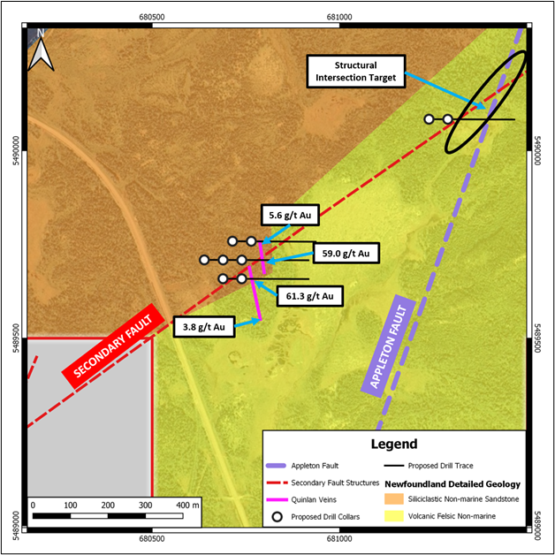
PHASE I DRILLING ASSAYS PENDING: QUINLAN VEINS
Located within the Dog Bay Gold Project at the northern extent of the Exploits Subzone, bound by the gold bearing Dog Bay Line and GRUB Line fault zones, and containing 21km of Appleton Fault (host to NFG’s Keats Zone Discovery).
Permitted for 9 drill holes totaling 2,250m.
The recently discovered Quinlan Veins sit along a GoldSpot interpreted secondary structure to the Appleton Fault and returned assays of 61.3, 59.0, 14.4, 14.2, 12.6, and 11.8 g/t Au, with 26 total samples assaying over 0.1 g/t Au with an average grade of 7.3 g/t Au.
Secondary structures along the northern Appleton Fault zone hosts historic wide spaced and shallow drilling (1,559m program) on Exploits’ land, which returned values of up to 3.35m at 10.22 g/t Au at the Titan Prospect, in the Southern Dog Bay Gold Project.

Slide 21
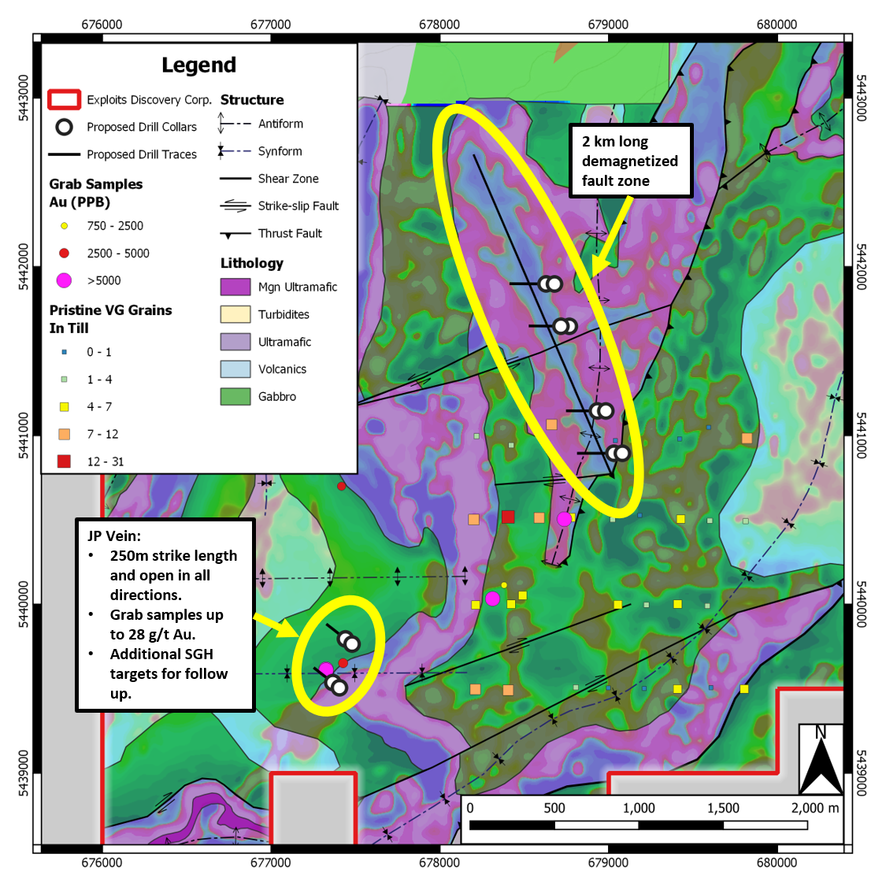
PHASE I DRILLING ONGOING: JONATHAN’S POND
The Jonathan’s Pond (JP) property is bordered by the prospective GRUB Line and Joe Batts Pond (JBP) fault zones and hosts outcrop with visible gold samples in quartz veining (JP Vein) up to 28 g/t Au in trenching and float samples up to 700 g/t Au. Highest grade Au till samples in Newfoundland.
Permitted for 12 holes totaling 3000m.
Detailed structural geology mapping and magnetic geophysical interpretation has delineated principal structural orientation associated with gold mineralization.
Newly highlighted 2 km demagnetized fault zone, in preferred structural orientation, over original staked and newly acquired land from New Found Gold Corp. Demagnetized fault zones are imperative for orogenic gold deposits as auriferous metamorphic fluids react with magnetite to produce gold
SGH soil sampling over the JP Vein highlighted an additional 300m of strike length to follow up with trenching and ground geophysics.

Slide 22
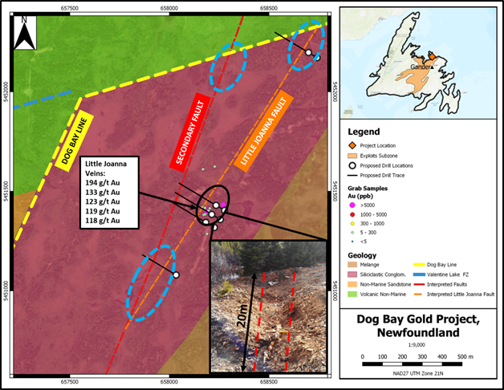
DRILL TARGET: LITTLE JOANNA
Newly discovered Little Joanna Quartz Veins with visible gold observed in outcrop, Nov. 2020. Quartz vein textures display similar appearance to New Found Gold's Keats Zone.
Permitted for 9 drill holes totaling 2,250m.
The Little Joanna Veins are situated on a secondary fault structure, identified by GoldSpot Discoveries geophysical analysis, sub-parallel to the deep-seated Dog Bay Line fault zone, providing ~2 km of discovery potential.
5 samples with visible gold, with assay returning 194, 133, 123, 119, and 118 g/t Au.
The quartz veins were uncovered up to 20 metres of strike length at an average width of 30 centimetres before becoming buried under overburden and are open in all directions.
Geology, structure, and newly discovered gold mineralization in outcrop provide immediate follow up exploration.

Slide 23
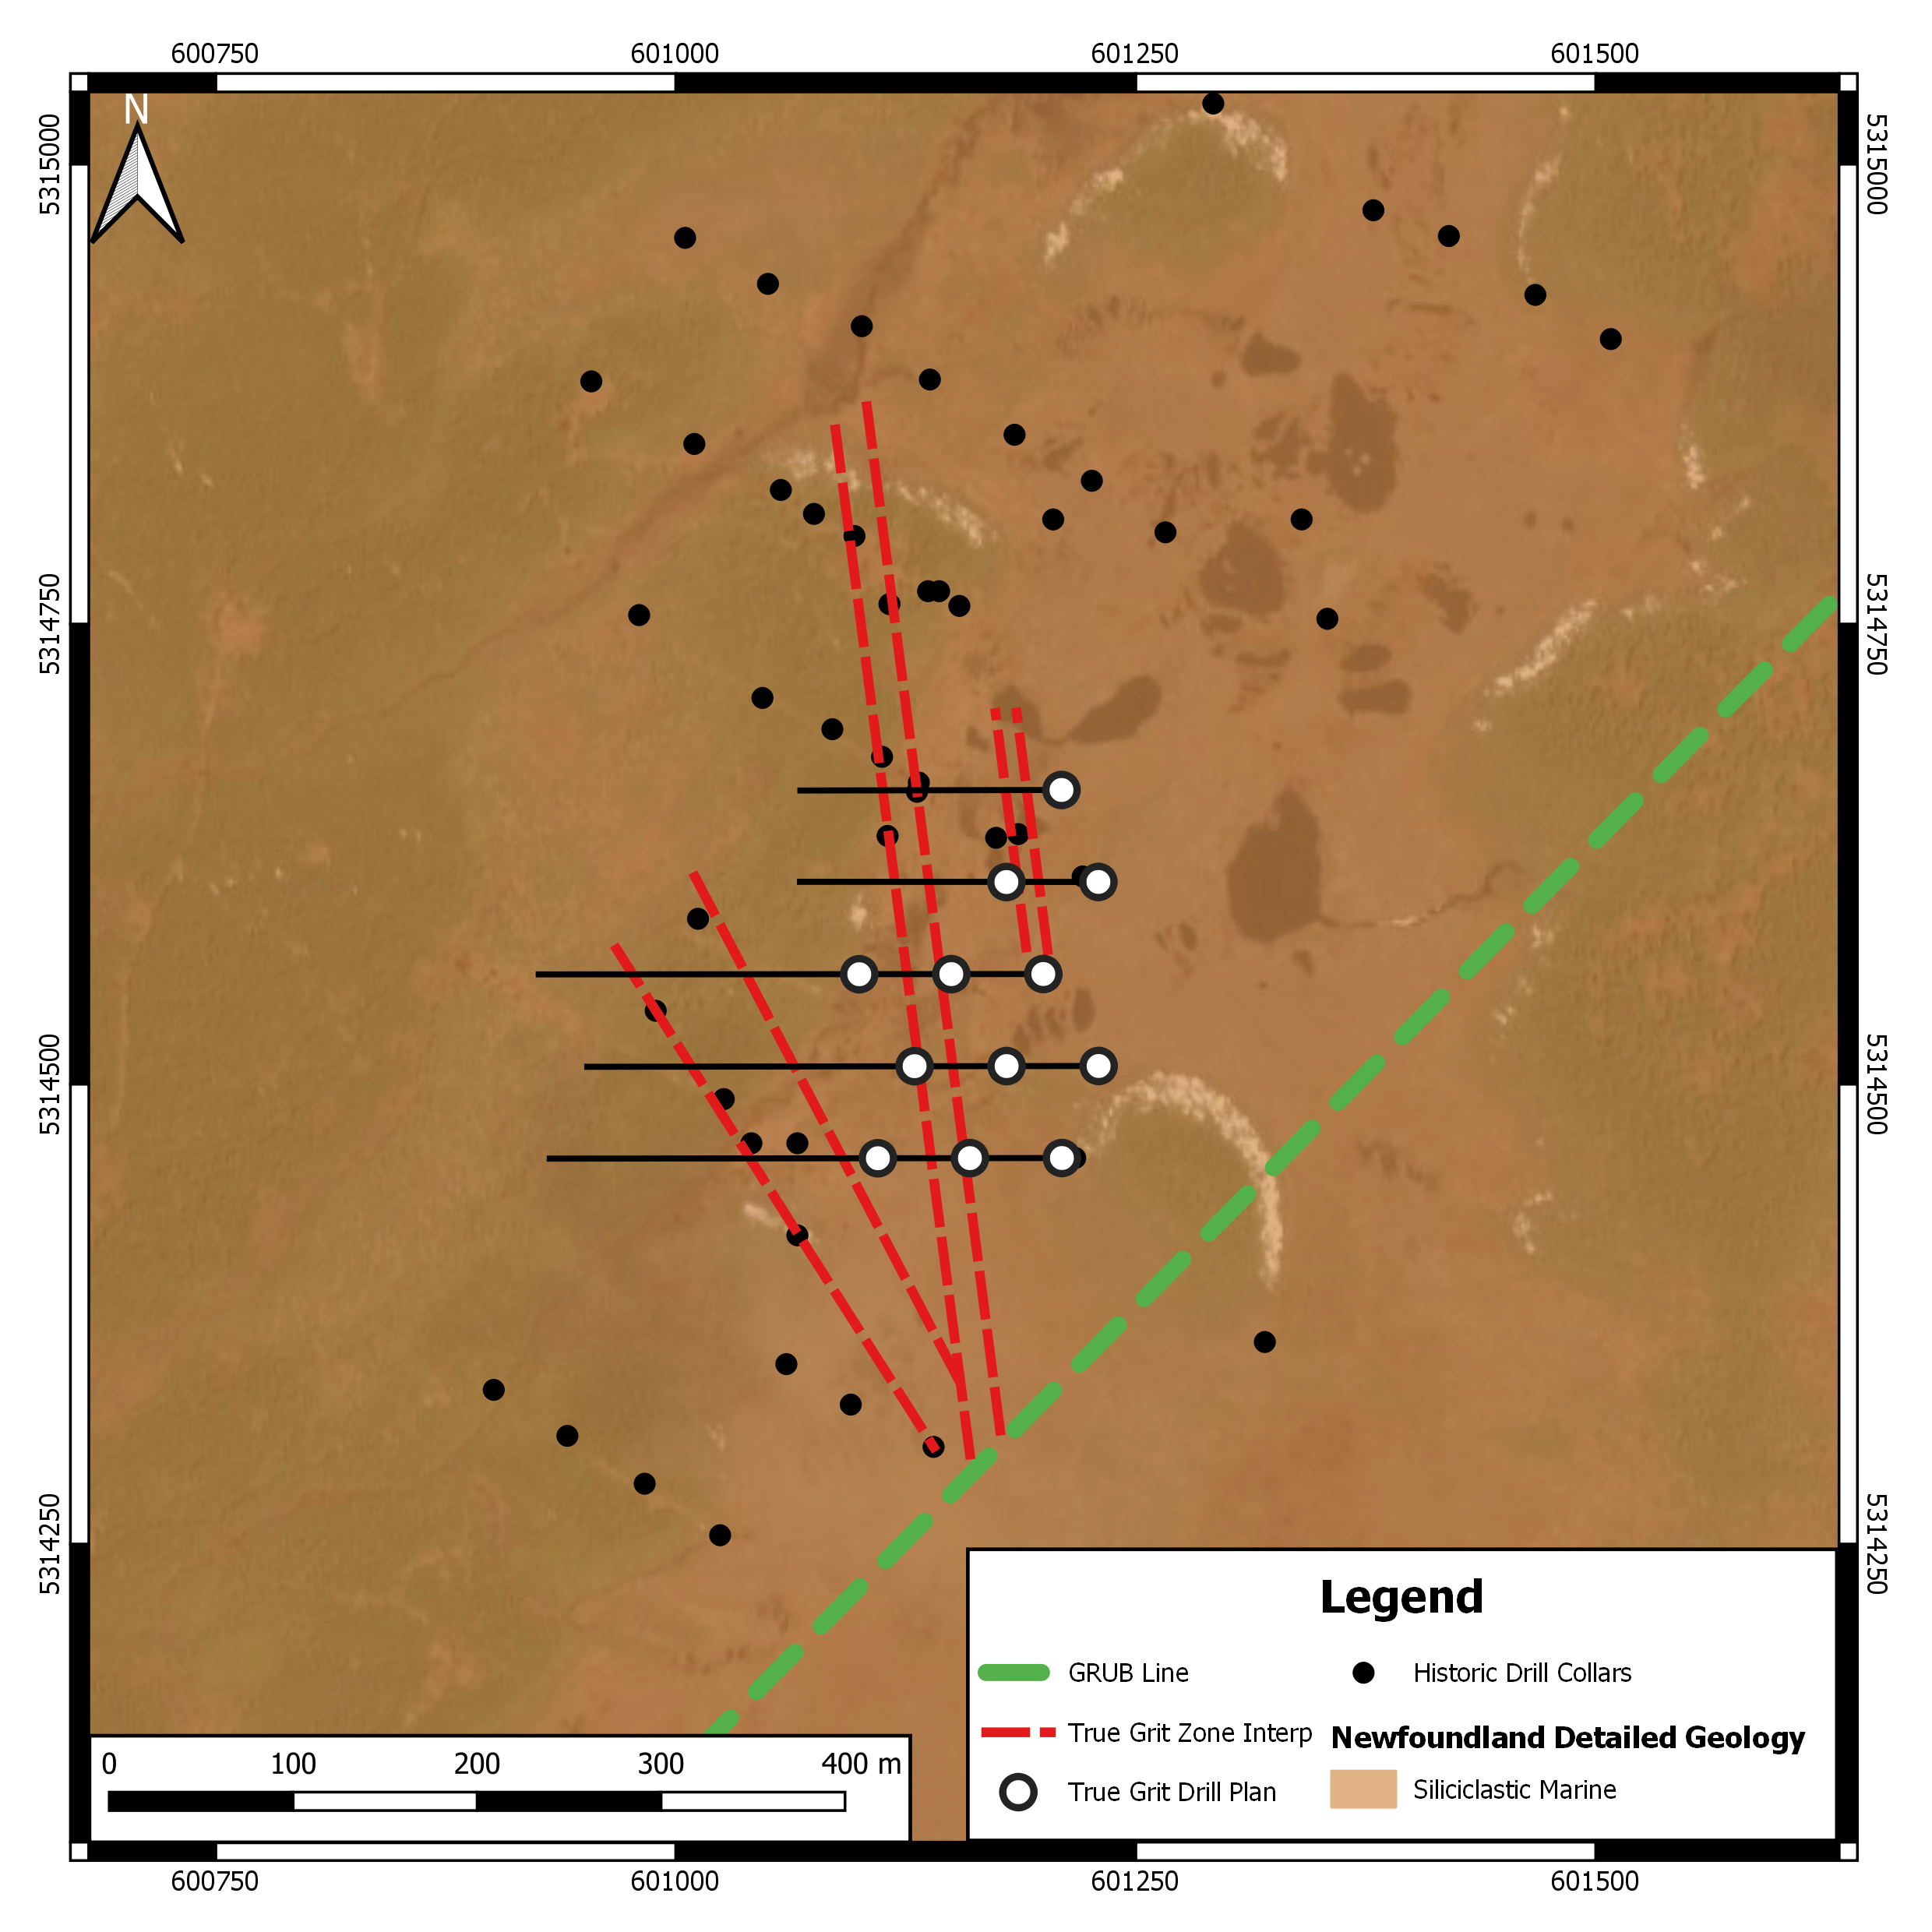
DRILL TARGET: TRUE GRIT
With 25 km of secondary structure parallel to the GRUB line, the property hosts channel samples of 15.6 g/t Au over 1.0m and grab samples of 30.2 g/t Au (Teck, 1990).
The property hosts geophysical anomalies coincident with Au-Sb-As soil anomalies which measure over 2.6km by 0.80km which would be expected in the Fosterville Model.
Currently conducting a high resolution, 13,500 line kilometre, airborne VTEM geophysical survey over Exploits’ southern projects.
Near surface, low grade, wide intercepts were drilled by Moydow Mines from 2003-2005, including 0.60 g/t Au over 117m from surface. (Moydow, 2003).
The True Grit property is accessible by the Bay d’Espoir Highway and located in south central Newfoundland.
TG-23:
0.67 g/t Au over 20.9m
TG-11:
0.58 g/t Au over 28.3m
TG-27:
0.55 g/t Au over 52m
Incl. 0.75 g/t Au over 14m
TG-36:
0.65 g/t Au over 32.3m
TG-37:
0.65 g/t Au over 14m
GRUB LINE
TG-4:
0.60 g/t Au over 117m
TG-96:
0.52 g/t Au over 46m
Incl. 0.85 g/t over 7m

Slide 24
DOG BAY
Dog Bay Line
and Appleton Fault
Visible gold in outcrops
SGH pending
EXPLOITS DISCOVERY DIFFERENCE
Largest land package and best in class properties in a developing gold camp
Nine unique projects (and counting)
Starting Drilling May 27th, 2021
Innovative exploration techniques; bring the world to our projects
Partnered wth Goldspot Discovery Corp. who have a record of discovery in the Exploits Subzone Gold Belt
Strong management, directors, advisory board and local team.
Cashed up with $14M
Very liquid shares
Listed on the CSE, OTCQB and Frankfurt exchanges.
MT. PEYTON NORTH
Intersection of Valentine Lake
Structure and Dog Bay line
GAZEEBOW
Joe Batts Pond Line
MT. PEYTON
164 g/t Au grab (Noranda)
JONATHAN’S POND
Visible gold in trenches
SGH + 350m trenching
NFG Partnership (9.9%)
NEW FOUND GOLD
GREAT BEND
Appleton Fault
Dog Bay line
Joe Batts Pond Line
EXPLOITS DISCOVERY
Katie Project
Gold and Zinc
VMS mineralization
MIDDLE RIDGE
GRUB Zone targets
Dog Bay Line
Appleton Linear
GRUB Line
Joe Batts Pond
Valentine Lake
TRUE GRIT
0.6 g/t over 117m
SGH completed
Notes:
With eight unique prospects across our claims, we have initiated soils sampling, geophysics, fieldwork programs in 2020 and those will continue in 2021 with the goal of advancing one or two high value opportunities ourselves.
This leaves huge opportunities for companies to partner with us, share in the risk, AND reward.
We welcome strong management teams and companies to approach us about ground they would like to acquire and explore. We will provide an overview of some key projects here, but detailed information is available on our website.
Our focus as a company is to use the best new technologies and geologic models to explore our ground.
With SGH soil sampling we can ‘see through’ glacial tills to bedrock where Gold can be detected.
Geophysics allows us to see the fault structures that control the deep seated mineralization
Geological modeling (Fosterville) and old fashioned field work (structural mapping, rock and trench sampling) give us a good understanding of the ground.
Artificial Intelligence helps pull all this together and identify targets that may be overlooked, and prioritize high value opportunities.
Exploits Discovery uses all of these tools, and will be advancing towards drilling quickly in early 2021.

Slide 25
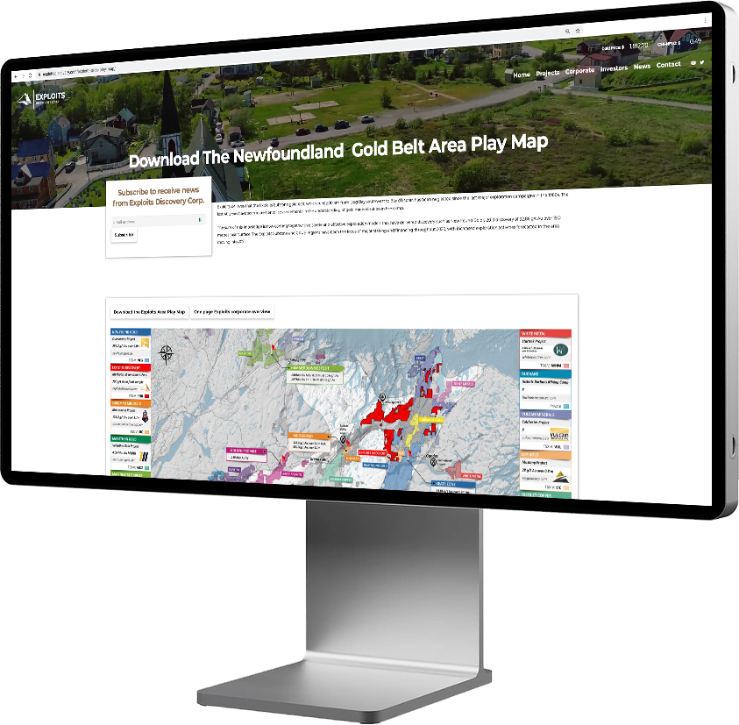
EXPLOITS SUBZONE AREA PLAY MAP
Exploits leads the way with the creation of the Exploits Subzone Area Play Map.
Over 30 companies currently participating in the Newfoundland Gold Rush.
WWW.EXPLOITS.GOLD
Download the latest version from our website – we update it regularly!

Slide 26
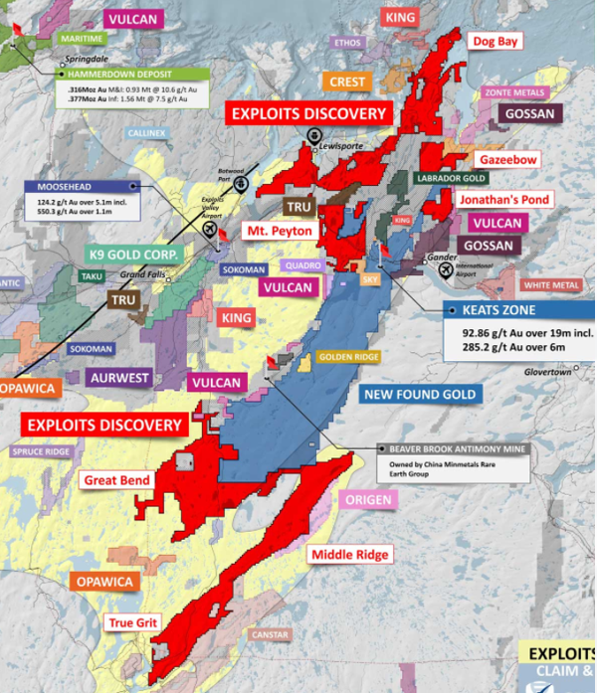
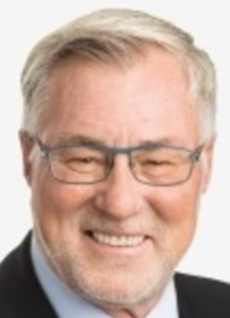
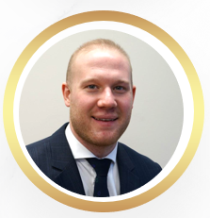
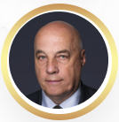
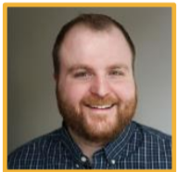
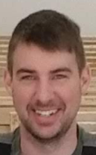
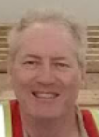
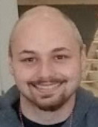
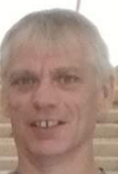
A Winning Team & Strategy with the Largest Land Package in NFL
Major
Shareholder
20+%
Major Shareholder
12+%
Our ADVISORY BOARD
LOCAL TEAM
“Structural geometry of orogenic gold deposits: Implications for exploration of world-class and giant deposits”
GoldSpot’s proven A.I. and data analysis technology which was the basis for New Found Gold’s Keats Zone discovery along the Appleton Fault Zone.

Slide 27
CONTACT
Jeff Swinoga, President & CEO
Exploits Discovery Corp.
+1 (778) 819-2708
investors@exploits.gold
CSE: NFLD
OTCQB: NFLDF
Frankfurt: A2QDKZ
www.exploits.gold
September 2021

